Slide 1
Module 2 Working with data: introduction to Bioimaging data

Slide 2
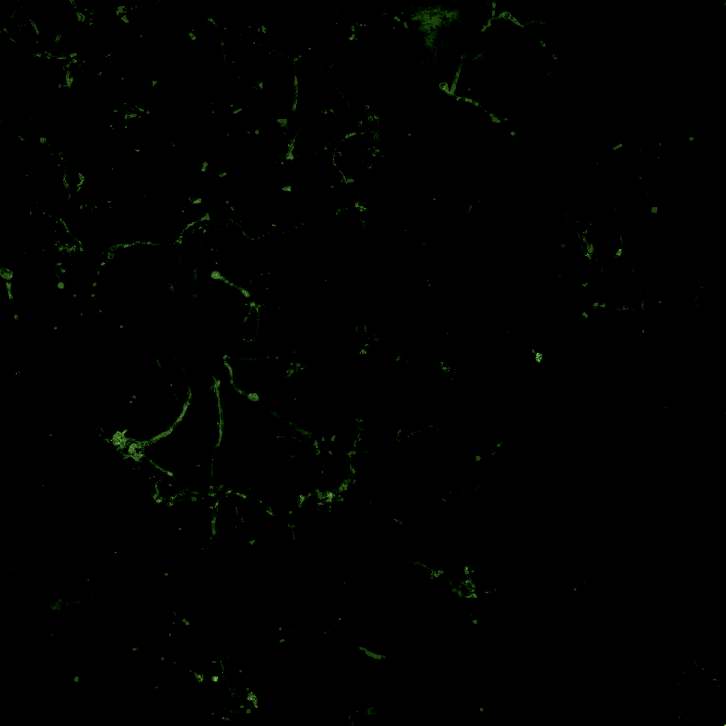
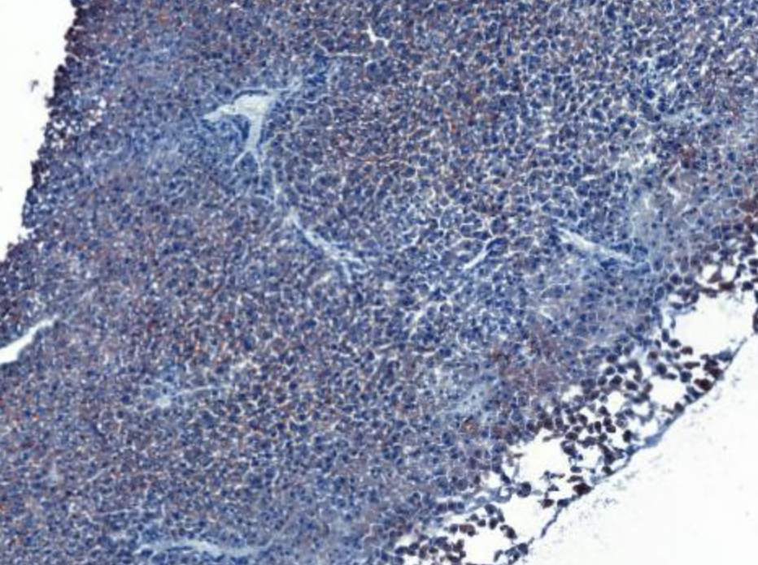
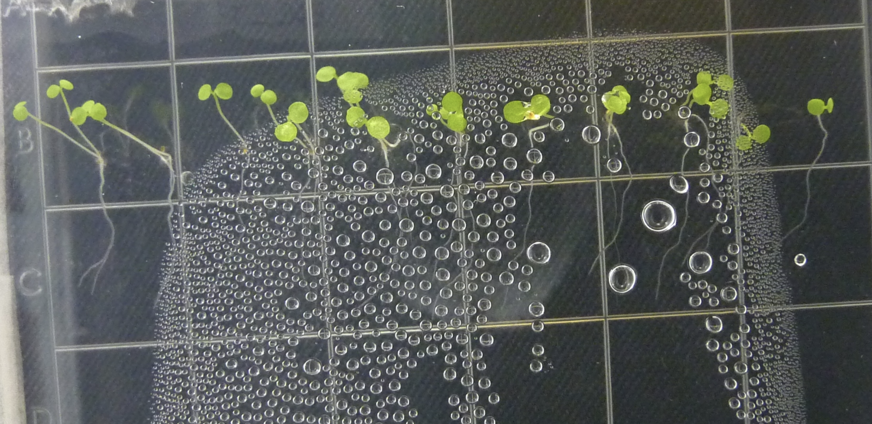
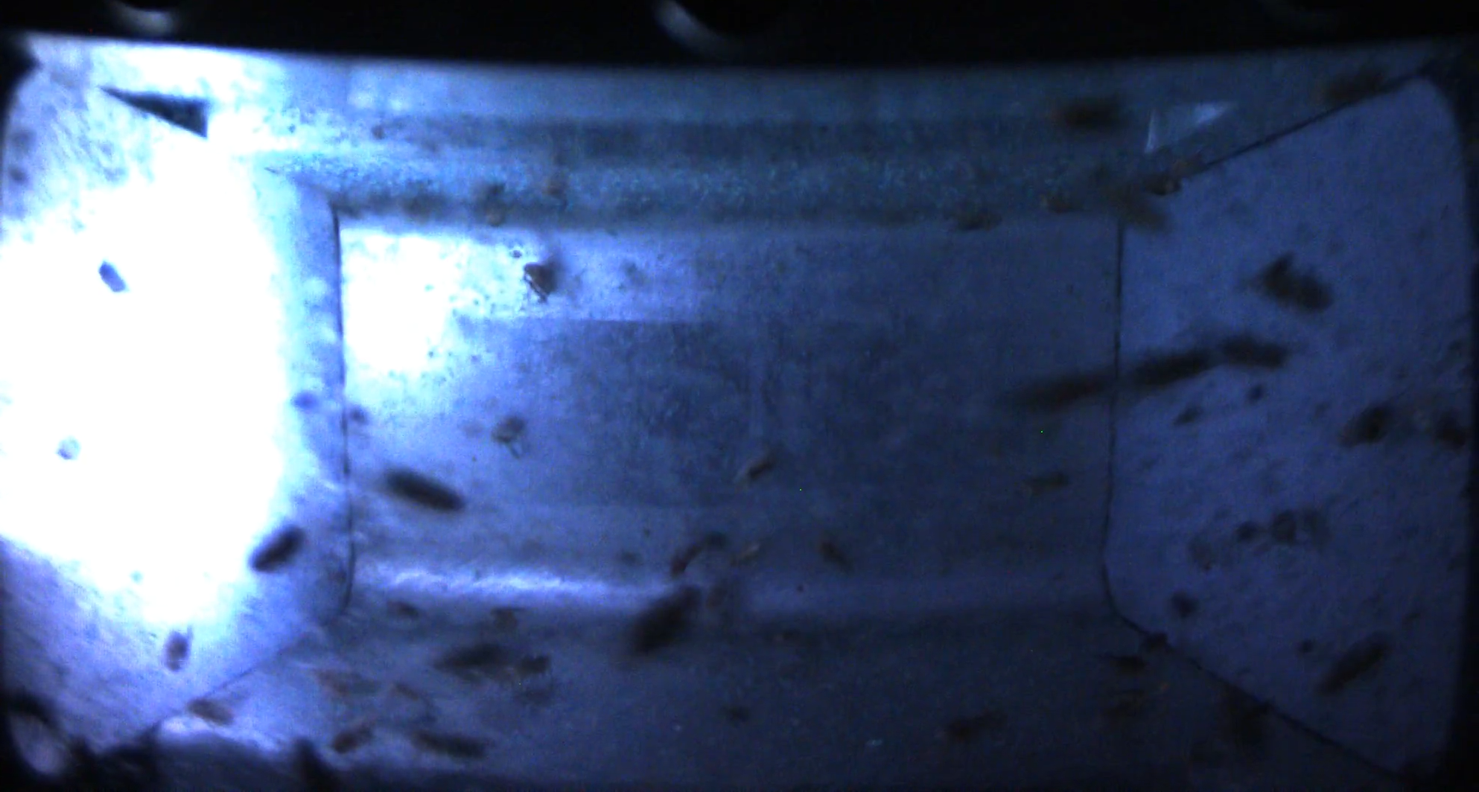
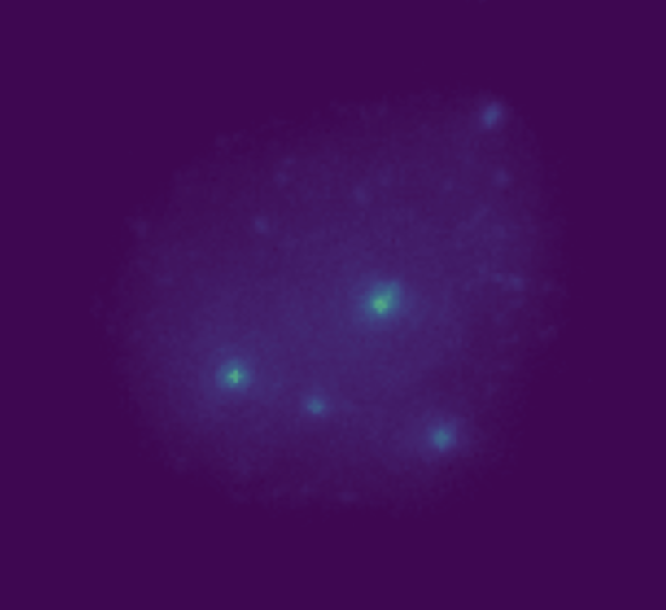
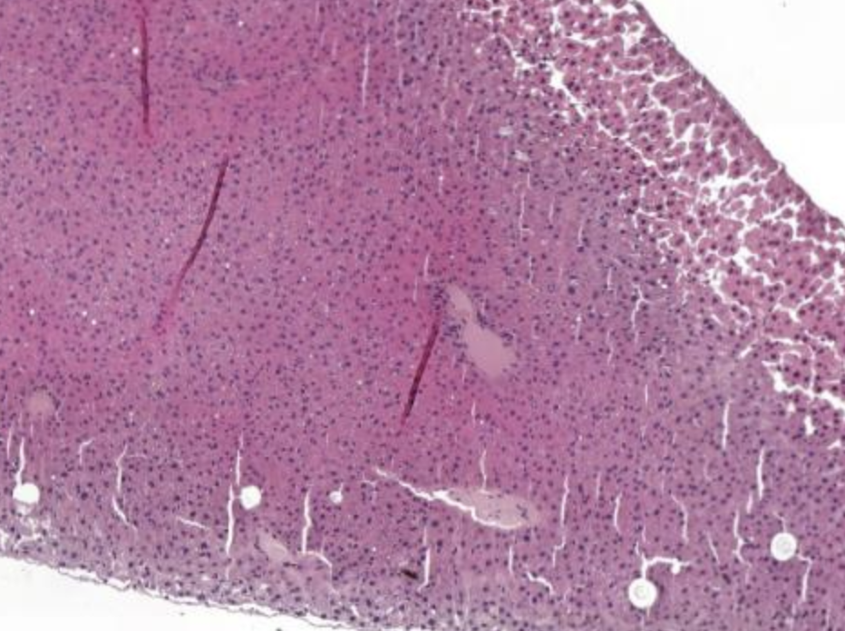
Many types of Bioimaging data
OSD-628
Biofilm formation in microgravity
OSD-48
Oil Red O (ORO) spaceflown mouse liver
OSD-120
Plant growth on ISS
OSD-595
Drosophila in artificial gravity
OSD-366 / AWS
DNA damage in radiation-exposed cells
OSD-48
H&E histology spaceflown mouse liver

Slide 3
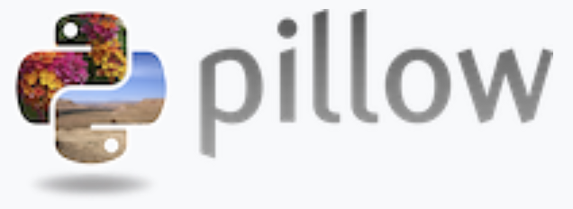

Working with bioimaging data in Python
Pillow
Library for opening, manipulating, and saving images
Basic image operations such as cropping, resizing, and rotating
Can handle multiple image file formats (e.g., JPEG, PNG, TIFF)
Matplotlib
Library for creating static, animated, and interactive visualizations
Can display images and overlaying plots on them
Together, Pillow and Matplotlib enable a complete bioimaging data analysis pipeline, from image preprocessing (Pillow) to detailed visualization (Matplotlib)

Slide 4
Bioimaging data loading and visualization
from PIL import Image
img = Image.open()
Open an image from an open file path
matplotlib.pyplot.imshow(img)
Display the opened image to the screen

Slide 5
Image resizing for Machine learning
img.resize((width, height))
Ensures all images in a dataset have the same dimensions
Input size requirements of certain ML algorithms and neural networks
Maintains uniformity in the dataset for accurate model predictions
Eliminates irrelevant details and noise from larger images
CAUTION: any change to an image may affect the biological signal.

Slide 6
Normalization for machine learning
image_array = np.array(img)
image_norm = image_array.astype(np.float32) / max
Convert the image to a numpy array, then divide by the maximum pixel value to normalize pixel intensity between 0 and 1
Ensures all images have similar pixel value ranges
Helps machine learning models converge faster during training
Helps models learn important features by eliminating variations in lighting, contrast, etc
Allows for uniform comparison across different images
CAUTION: In many bioimaging applications, such as microscopy, the intensity of pixels in the image is the important feature for model prediction.

Slide 7
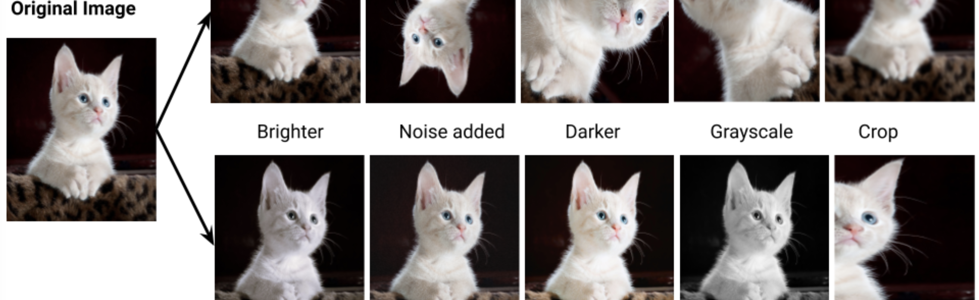
Image augmentation
Creates new, slightly altered versions of existing images to expand the dataset
Reduces overfitting by exposing the model to more diverse training examples
Mimics real-world scenarios/practical applications
Makes the model focus on important features
Common Types of Image Augmentation for Machine Learning
Flipping
Cropping
Rotation
Scaling
Translation
Shearing
Zooming
Brightness Adjustment
Contrast Adjustment
Noise Addition
Color Jittering
Blurring
Elastic Deformation
https://ubiai.tools/what-are-the-advantages-anddisadvantages-of-data-augmentation-2023-update/

